Slide 1
Chest X-Ray Analysis using Deep Learning
Presented By –
Mansi Kumari - 10900218051
Seema Rani - 10900218030
Anindita Mitra Neogi – 10900219006
IT 4th Year (INFORMATION TECHNOLOGY)

Slide 2
CONTENTS
INTRODUCTION
RELATED WORK
PROPOSED WORK
OBJECTIVE
SYSTEM DESIGN
5.1 FLOW CHART
5.2 DATASET
5.3 CNN MODEL
5.4 SEMANTIC SEGMENTATION
5.5 UNET ARCHITECTURE
IMPLEMENTATION DETAILS
APPLICATION
CONCLUSION
9. REFERENCES

Slide 3
INTRODUCTION
X-Ray Radiography
Chest x-ray uses a very small dose of ionizing radiation to produce pictures of the
inside of the chest.
It is used to evaluate the lungs, heart and chest wall and may be used to help
diagnose shortness of breath, persistent cough, fever, chest pain or injury.
It also may be used to help diagnose and monitor treatment for a variety of lung
conditions such as pneumonia, emphysema and cancer.
In clinical practice, the CXR images are typically interpreted by radiologists and
this process is time-consuming and prone to subjective assessment errors.
As an emerging technology deep learning has demonstrated remarkable
strength in a variety tasks of medical image analyses, such as disease
classification, segmentation, and registration.
In this project, we used U-Net architecture of the convolutional neural network
along with semantic segmentation.

Slide 4
U-Net
U-Net, evolved from the traditional convolutional neural network, was first
designed and applied in 2015 to process biomedical images.
CNN focuses its task on image classification, where input is an image and
output is one label, but in biomedical cases, it requires us not only to
distinguish whether there is a disease, but also to localise the area of
abnormality. U-Net is dedicated to solving this problem.
It is able to localise and distinguish borders is by doing classification on
every pixel, so the input and output share the same size.
Semantic Segmentation
There are various levels of granularity in which the computers can gain
an understanding of images.

Slide 5
Continued.....
For each of these levels there is a problem defined in the Computer
Vision domain. One of them is semantic segmentation.
It labels each pixel of an image with a corresponding class of what is being represented.
This task is commonly referred to as dense prediction.
The output itself is a high resolution image, Thus it is a pixel level image classification.
Segmented images of xray are helpful in many ways. For example, Accurate diagnoses,
Cancer detection, Surgical procedures, etc.
Considering the formula of calculating the pixels size, mass of segmented image
is calculated and compared to average mass of lungs and heart which helps to
know the chances of disease in any xray. Following are some examples of diseases.
The term "cardiomegaly" refers to an enlarged heart seen on any imaging test,
including a chest X-ray. An enlarged heart may be easier to treat when it's
detected early.

Slide 6
Continued…
Hyperinflated lungs occur when air gets trapped in the lungs and causes them to overinflate.
Hyperinflated lungs are often seen in people with chronic obstructive pulmonary
disease (COPD) — a disorder that includes emphysema. Certain lung problems, such
as asthma and cystic fibrosis, also can cause hyperinflation.

Slide 7
RELATED WORK
Following are the commonly used architectures categorized by types of application in the CXR literature :
CONVOLUTIONAL NEURAL NETWORKS
In the 1980s, networks using convolutional layers were first introduced for image
analysis (Fukushima and Miyake, 1982), and the idea was formalized over the
following years (LeCun and Bengio, 1998).
The above model uses basic architectures which is not sufficient for image
processing.
TRANSFER LEARNING
Transfer learning investigates how to transfer knowledge extracted from one domain
(source domain) to another (target) domain.

Slide 8
With the pre-training approach, the network architecture is first trained on a large
dataset for a different task, and the trained weights are then used as an
initialization for the subsequent task for fine-tuning (Yosinski et al., 2014).
SEGMENTATION NETWORKS
Early approaches to segmentation using deep learning used standard convolutional
architectures designed for classification tasks (Chen et al., 2018b).
The main drawback to this approach is that neighbouring patches have huge
overlap in pixels, resulting in inefficiency caused by repeating the same convolutions
many times.
It additionally treats each pixel separately which results in the method being
computationally expensive and only applicable to small images or patches from an
image.
In 2015, a fully convolutional architecture known as the U-Net was proposed
(Ronneberger et al., 2015) and this work has become the most cited paper in the
history of medical image analysis.
The majority of image segmentation works in this review employ a variant of the
FCN or the U-Net.

Slide 9
PROPOSED WORK
Among all the models we found U-Net architecture gives better result.
As a general convolutional neural network focuses its task on image classification, where
input is an image and output is one label, but in biomedical cases, it requires us not only to
distinguish whether there is a disease, but also to localise the area of abnormality.
Deep Learning is a subset of artificial intelligence function that provides the system with the
ability to learn from data without being programmed explicitly.
This is basically a mathematical and probabilistic model which requires tons of computations.
Consumer hardware may not be able to do extensive computations very quickly as a model
may require to calculate and update millions of parameters in run-time for a single iterative
model like deep neural networks.

Slide 10
Continued.....
Deep learning is a very CPU intensive program-esque thing to be running, so be prepared to
shell out a lot of money for a good enough system.
Here are some system requirements:
A minimum of 8GB RAM can do the job, 16GB RAM recommended for most deep
learning tasks. When it comes to CPU, a minimum of 7th generation (Intel Core i7
processor) is recommended.
Python, Flask and other libraries are required like TensorFlow, NumPy, Pandas,
Scikit-Learn, Keras, Matplotlib, etc.

Slide 11
OBJECTIVES
Deep learning is the most successful technique of machine learning, which provides useful
analysis to study a large amount of chest x-ray images.
The main objective of this project is to help in reducing the workload of radiologists in
analysing chest x-ray.
To analyze any X-ray image, one has to upload the image in .png format.
The model will predict whether there is any disease(like- Pneumonia, Lung cancer,
Pulmonary tuberculosis, Inflammatory mass etc.) present in chest area or not.

Slide 12
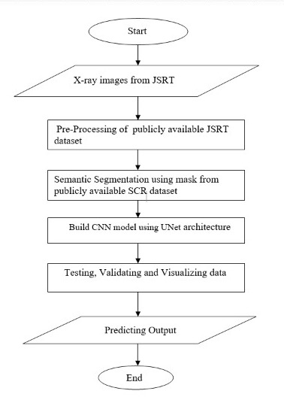
SYSTEM DESIGN
Flow Chart:
Dataset:
This model use a multi-class configuration
with three target classes and are trained
and tested on the publicly available
JSRT database, consisting of 247 X-ray
images the ground-truth masks for which
are available in the SCR database.

Slide 13
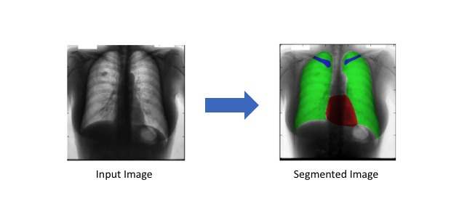
Continued.....
Semantic Segmentation:
The goal of semantic image segmentation is to
label each pixel of an image with a corresponding
class of what is being represented.
Because we’re predicting for every pixel in the
image, this task is commonly referred to as dense
prediction.

Slide 14
Continued.....
U-Net Architecture and Training:
The UNET was developed by Olaf Ronneberger et al. for Bio Medical Image Segmentation.
The architecture contains two paths.
First path is the contraction path (also called as the encoder) which is used to capture the
context in the image. The encoder is just a traditional stack of convolutional and max pooling
layers.
The second path is the symmetric expanding path (also called as the decoder) which is used to
enable precise localization using transposed convolutions.
Thus it is an end-to-end Fully Convolutional Network (FCN), i.e. it only contains Convolutional
layers and does not contain any Dense layer because of which it can accept image of any size.

Slide 15
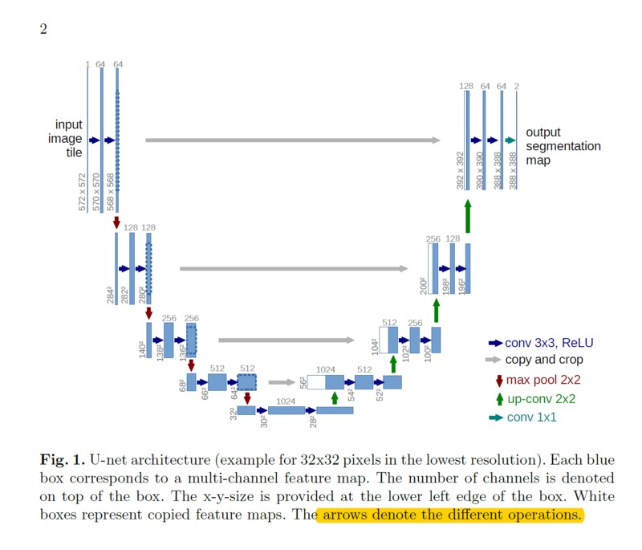
Continued.....
In the original paper, the size of the
input image is 572x572x3, however,
we will use input image of size
128x128x3.
Hence the size at various locations will
differ from that in the original paper but
the core components remain the same.

Slide 16
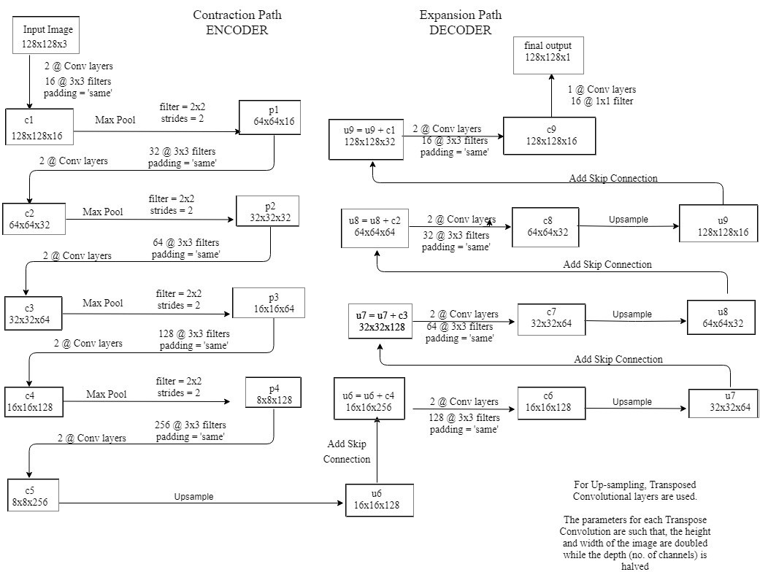
Continued.....
Below is the detailed explanation of the architecture:

Slide 17
Continued.....
Points To Note:
2@Conv layers means that two consecutive Convolution Layers are applied.
c1, c2, …. c9 are the output tensors of Convolutional Layers.
p1, p2, p3 and p4 are the output tensors of Max Pooling Layers.
u6, u7, u8 and u9 are the output tensors of up-sampling (transposed convolutional) layers.
The left hand side is the contraction path (Encoder) where we apply regular convolutions
and max pooling layers.
In the Encoder, the size of the image gradually reduces while the depth gradually
increases. Starting from 128x128x3 to 8x8x256.
This basically means the network learns the “WHAT” information in the image, however it
has lost the “WHERE” information.
The right hand side is the expansion path (Decoder) where we apply transposed
convolutions along with regular convolutions.

Slide 18
Continue.....
In the decoder, the size of the image gradually increases and the depth
gradually decreases. Starting from 8x8x256 to 128x128x1.
Intuitively, the Decoder recovers the “WHERE” information (precise localization)
by gradually applying up-sampling
To get better precise locations, at every step of the decoder we use skip
connections by concatenating the output of the transposed convolution layers
with the feature maps from the Encoder at the same level:
u6 = u6 + c4
u7 = u7 + c3
u8 = u8 + c2
u9 = u9 + c1
After every concatenation we again apply two consecutive regular convolutions
so that the model can learn to assemble a more precise output.
This is what gives the architecture a symmetric U-shape, hence the name UNET.
On a high level, we have the following relationship : Input (128x128x1) =>
Encoder =>(8x8x256) => Decoder =>Ouput (128x128x1)

Slide 19
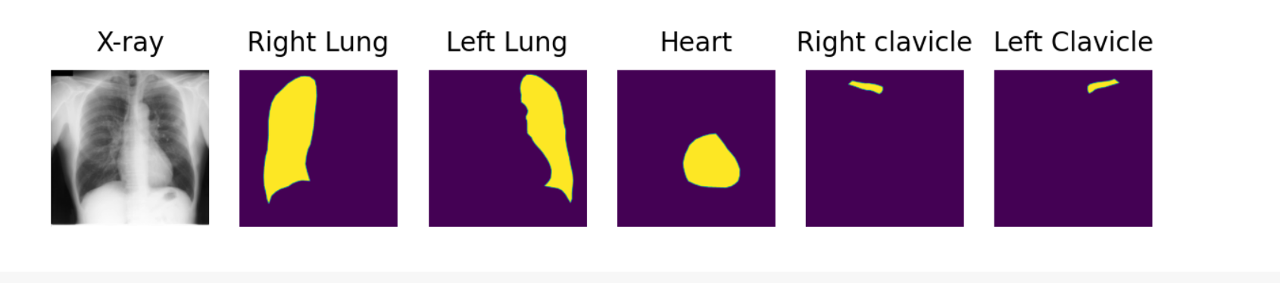
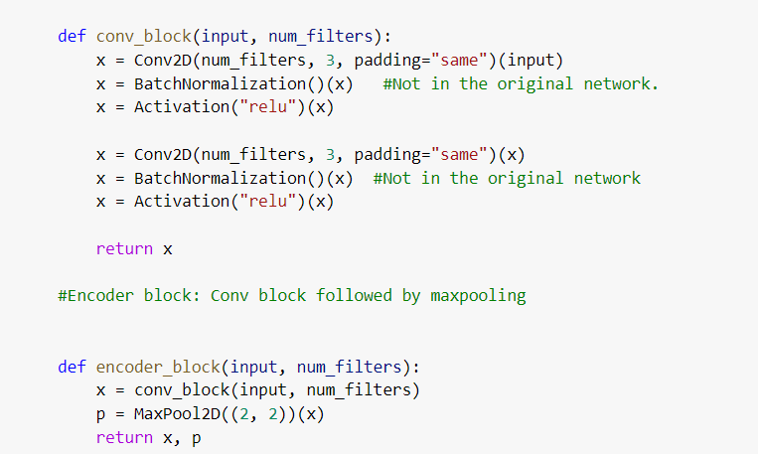
IMPLEMENTATION DETAILS
Input with their masks:
Unet Architecture Model:

Slide 20
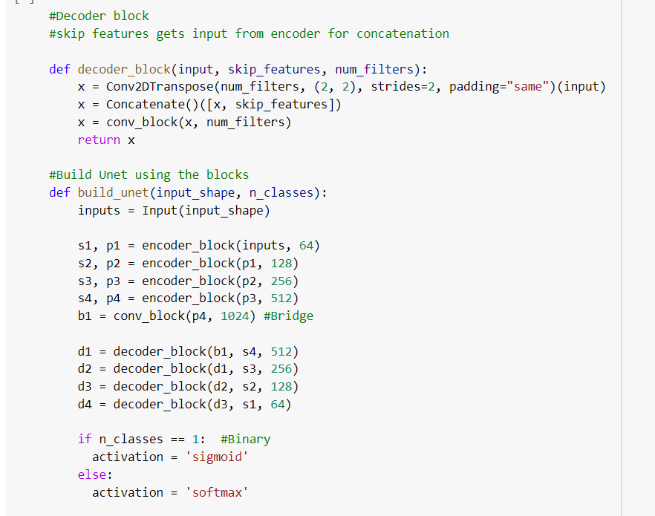
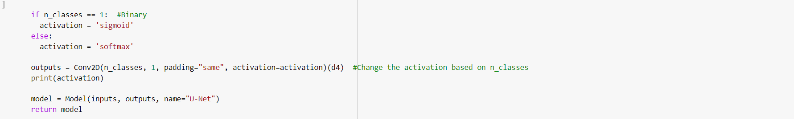
Continued....

Slide 21
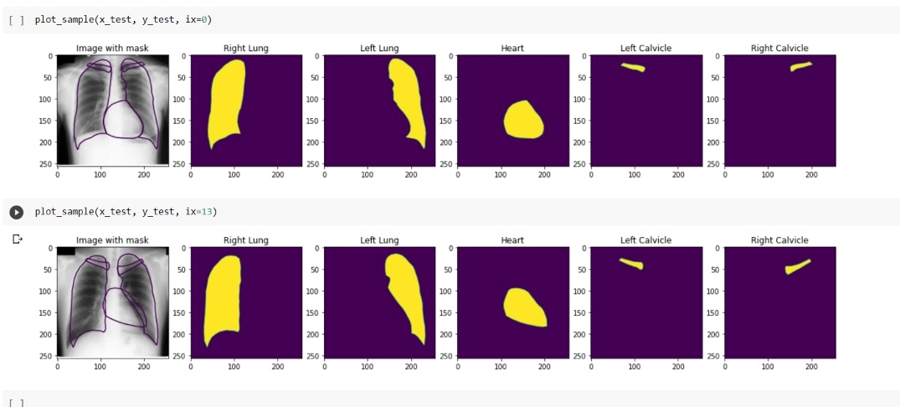
Continue....
Output:
The segmented images are further saved and calculate count of each pixels in images. Firstly coefficient for mass calculation is calculated using following formula:

Slide 22
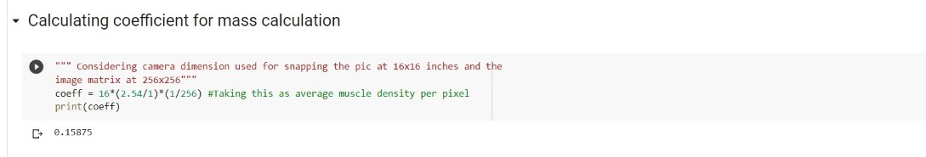
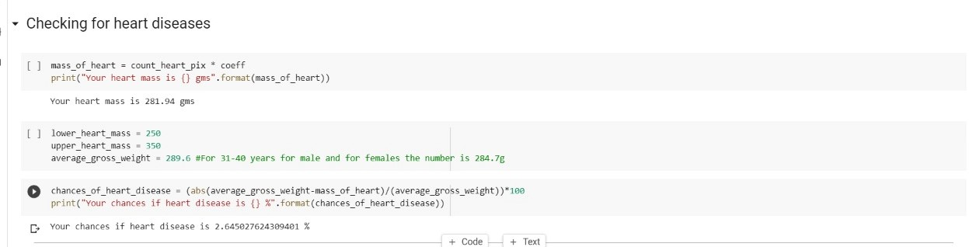
Continued…
Now checking the chances of heart disease. Similarly for both the lungs.

Slide 23
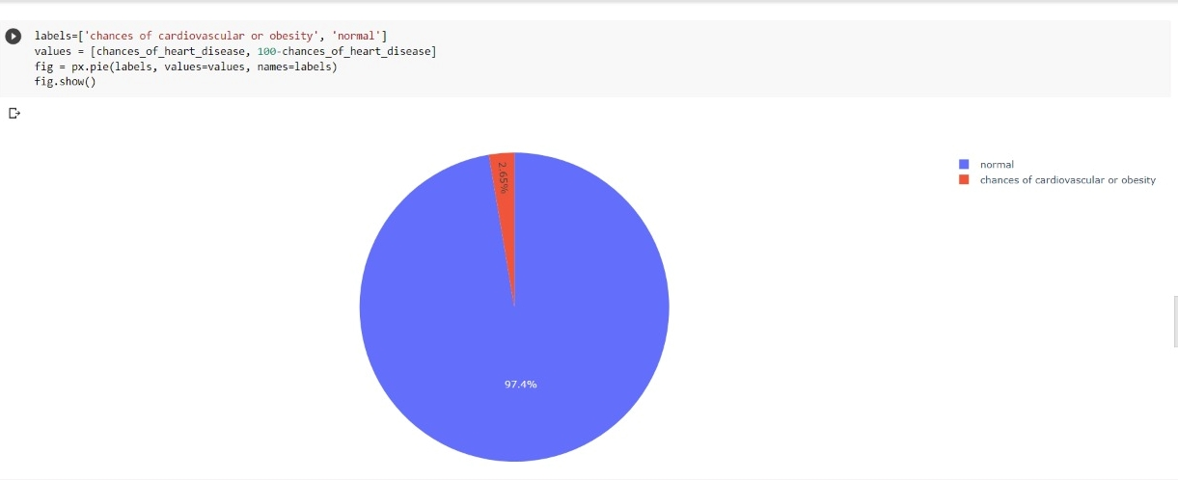
Continued….

Slide 24
APPLICATION
There are many applications of image segmentation of medical imaging including volume rendered
images from computed tomography and magnetic resonance imaging.
For Example, Locate tumors and other pathologies, Measure tissue volumes, Diagnosis, study of
anatomical structure, Surgery planning, Virtual surgery simulation, Intra-surgery navigation.

Slide 25
FUTURE WORK
The accuracy that we have achieved is approx. 92% which can be further increased by increasing the size of data or increasing the depth of model.
The data in JSRT dataset is very less. So for better accuracy , more number of images are required.

Slide 26
Conclusion
In this project, we review all studies using deep learning on chest radiographs, categorizing works by task: image-level prediction (classification and regression), segmentation, localization, image generation and domain adaptation.
And then selected a model where segmentation along with UNet architecture of convolutional neural network is used.
There are many application like, getting clear observation of xrays, predicting the chances of diseases, etc.
In this project, chances of getting heart and lung diseases are predicted by calculating the pixel size and comparing with the average mass of heart and lungs.

Slide 27
REFERENCES
https://towardsdatascience.com/unet-line-by-line-explanation-9b191c76baf5
https://towardsdatascience.com/understanding-semantic-segmentation-with-unet-6be4f42d4b47
https://towardsdatascience.com/types-of-convolutions-in-deep-learning-717013397f4d
https://github.com/zubaerimran/prepare_jsrt/blob/master/prepare_jsrt.ipynb
https://github.com/sohiniroych/U-net-for-Multi-class-semantic-segmentation
https://blog.paperspace.com/unet-architecture-image-segmentation/
https://arxiv.org/abs/1701.08816
Yosinski, J., Clune, J., Bengio, Y., Lipson, H., 2014. How transferable are features in deep neural networks?, in: Advances in Neural Information Processing Systems, Curran Associates, Inc.. pp. 1–9.
Baltruschat, I., Steinmeister, L., Nickisch, H., Saalbach, A., Grass, M., Adam, G., Knopp, T., Ittrich, H., 2020. Smart chest X-ray worklist prioritization using artificial intelligence: a clinical workflow simulation. Eur. Radiol.doi:10.1007/s00330-020-07480-7.
Baltruschat, I.M., Nickisch, H., Grass, M., Knopp, T., Saalbach, A., 2019a. Comparison of Deep Learning Approaches for Multi-Label Chest X-Ray Classification. Scientific Reports 9, 6381. doi:10.1038/s41598- 019-42294-8.

Slide 28
Continued.....
Baltruschat, I.M., Steinmeister, L., Ittrich, H., Adam, G., Nickisch, H., Saalbach, A., von Berg, J.,
Grass, M., Knopp, T., 2019b. When Does Bone Suppression And Lung Field Segmentation Improve
Chest X-Ray Disease Classification?, in: 2019 IEEE 16th International Symposium on Biomedical
Imaging (ISBI 2019), IEEE. pp.1362–1366.doi:10.1109/ISBI.2019.8759510.
12. Krizhevsky, A., Sutskever, I., Hinton, G.E., 2012. ImageNet Classification with Deep Convolutional
Neural Networks.
Girshick, R., 2015. Fast r-CNN, in: 2015 IEEE International Conference on Computer Vision (ICCV), IEEE. pp. 1440–1448. doi:10.1109/iccv.2015.169.
Girshick, R., Donahue, J., Darrell, T., Malik, J., 2014. Rich feature hierarchies for accurate object detection and semantic segmentation, in: 2014 IEEE Conference on Computer Vision and Pattern Recognition, IEEE. pp. 580–587. doi:10.1109/cvpr.2014.81.
Chen, L.C., Papandreou, G., Kokkinos, I., Murphy, K., Yuille, A.L., 2018b. DeepLab: Semantic image segmentation with deep convolutional nets, atrous convolution, and fully connected CRFs. IEEE Transactions on Pattern Analysis and Machine Intelligence 40, 834–848. doi:10.1109/tpami.2017.2699184.
Yu et al. (2020) A model based on U-Net and Faster R-CNN to detect PICC catether and its tip.

Slide 29
Continued…
17. https://www.ahajournals.org/doi/10.1161/CIR.0000000000000973
18. https://www.ncbi.nlm.nih.gov/pmc/articles/PMC3250069/
19. http://www.people.vcu.edu/~mhcrosthwait/clrs322/pixelconnect.html
20. https://www.bing.com/search?q=volume+of+left+lung&cvid=124d5f1cbe414e7b803c3a66e
7630c80&aqs=edge..69i57.4481j0j1&FORM=ANNTA1&PC=LCTS
21. https://www.google.com/search?q=mass+of+heart+in+cm&ei=MnOQYvuOPILCz7sP3YC_kAQ&ved=
0ahUKEwj777KOiv_3AhUC4XMBHV3AD0IQ4dUDCA4&uact=5&oq=mass+of+heart+in+cm&gs_lcp=
Cgdnd3Mtd2l6EAMyBAgAEEcyBAgAEEcyBAgAEEcyBAgAEEcyBAgAEEcyBAgAEE cyBAg
AEEcyBAgAEEc6BwgAEEcQsANKBAhBGABKBQhAEgExSgQIRhgAUDRYNGCiBWgBcAJ4AIABAI
gBAJIBAJgBAKABAcgBCMABAQ&sclient=gws-wiz

Slide 30
Thank You

